Slide 1
5G NR RLC ARQ Process
3GPP TS 38.322

Slide 2
Introduction
• 5G networks require ultra-reliable and low-latency data transmission for services like IoT, and video streaming.
• The RLC layer ensures ordered and error-free delivery of data between PDCP and MAC layers.
• ARQ mechanism helps in detecting packet loss and retransmitting missing data.
• This project demonstrates ARQ working through C++ simulation.

Slide 3
5G Protocol Stack
• PDCP handles security, header compression, and data forwarding.
• RLC performs segmentation, reassembly, and error control using ARQ.
• MAC manages scheduling and fast retransmissions using HARQ.
• PHY layer handles modulation, coding, and wireless transmission.
➡ RLC plays a key role in reliability.

Slide 4
Introduction to RLC ARQ
RLC Layer Overview
Key Highlights
The Radio Link Control (RLC) layer is a critical component of the 5G NR protocol stack, positioned between PDCP and MAC layers.
RLC operates in three modes:
• Transparent Mode (TM)
• Unacknowledged Mode (UM)
• Acknowledged Mode (AM)
ARQ mechanism is implemented exclusively in AM mode, providing reliable data delivery through automatic retransmission of lost PDUs.
Layer 2 Protocol
Reliable Delivery
Retransmission
Flow Control
In-Order Delivery

Slide 5
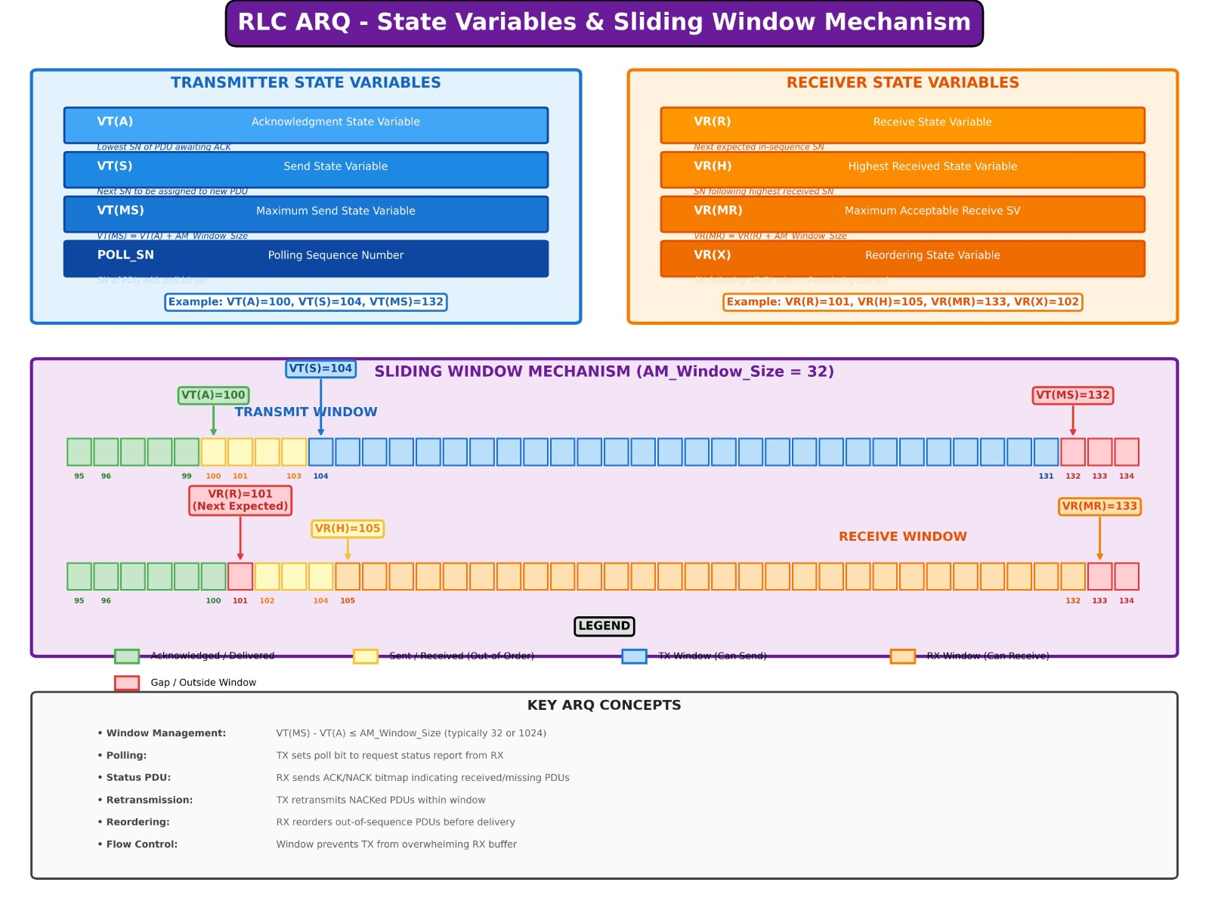

Slide 6
RLC Architecture Overview
Protocol Stack Position
RLC AM Entity Structure
PDCP Layer
Transmitting Side
Ciphering, Header Compression
• SDU reception from PDCP
• PDU construction & segmentation
• Polling & retransmission
• STATUS processing
RLC Layer
ARQ operates here
MAC Layer
Receiving Side
Scheduling, HARQ
• PDU reception & reordering
• Duplicate detection
• In-order delivery to PDCP
• STATUS report generation
PHY Layer
Modulation, Coding

Slide 7
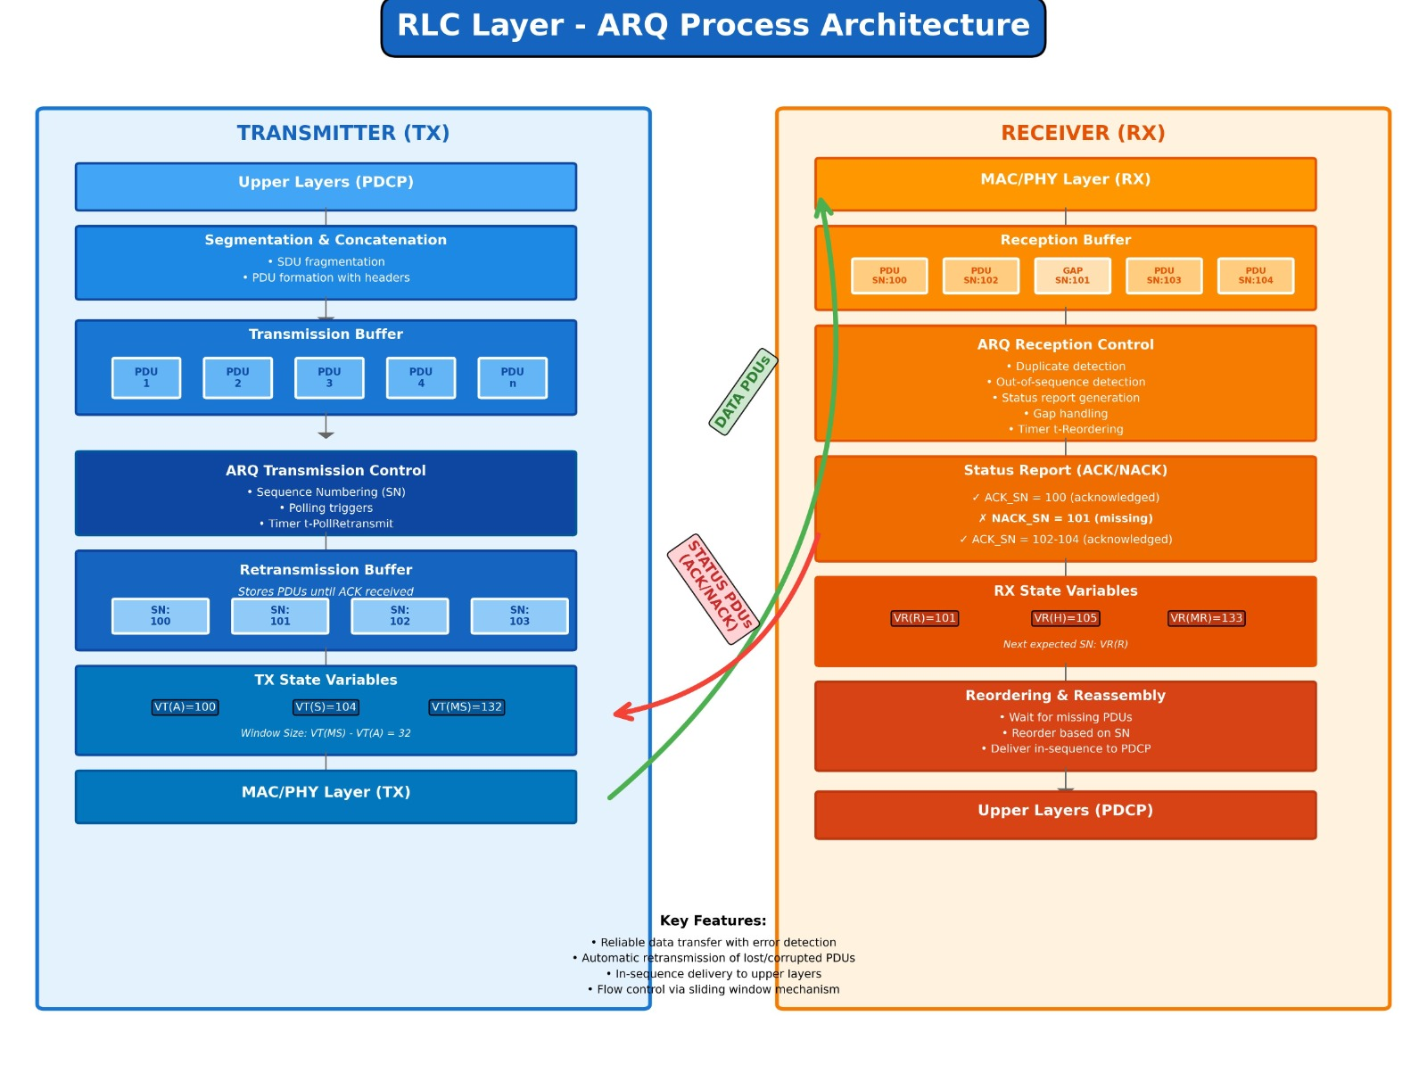

Slide 8
ARQ Process Flow
1
SDU Reception
2
PDU Construction
PDCP submits SDUs to RLC transmitter
Build AMD PDUs with headers (D/C, P, SI, SN)
3
Polling
4
Transmission
Set Poll bit based on triggers
Submit to MAC layer for air interface
5
Reception
6
In-Order Delivery
Receiver buffers and validates PDU
Deliver consecutive PDUs to PDCP
7
STATUS Report
8
Retransmission
Generate ACK/NACK feedback
Retransmit NACKed PDUs

Slide 9
C++ Implementation Overview
Step 1: Data Structures & Enums
PollBit, SDU, PDU, STATUS_PDU
Step 2: Configuration Parameters
RLC_AM_Config with 3GPP TS 38.331 compliance
Step 3: Transmitter Implementation
RLC_AM_Transmitter class with ARQ logic
Step 4: Receiver Implementation
RLC_AM_Receiver class with in-order delivery and STATUS generation
Step 5: Main Simulation
Complete ARQ process orchestration

Slide 10
Key Data Structures
PollBit (Polling Field)
AMD_PDU_Header
P_NOT_SET = 0
P_SET = 1
sn : Sequence Number
poll : Polling flag
size : SDU size
retx : Retransmission count
SDU (Service Data Unit)
STATUS_PDU (ARQ Feedback)
id : SDU identifier
size : Size of data from PDCP
ack_sn : All SNs below this are acknowledged
nacks : List of missing SNs for retransmission

Slide 11
RLC AM Configuration Parameters
Parameter | Value | Description
total_sdus | 8 | Number of SDUs submitted from PDCP
pollPDU | 4 | Trigger poll after every 4 PDUs
maxRetx | 3 | Maximum retransmission attempts
error_rate | 25% | Simulated channel packet loss rate

Slide 12
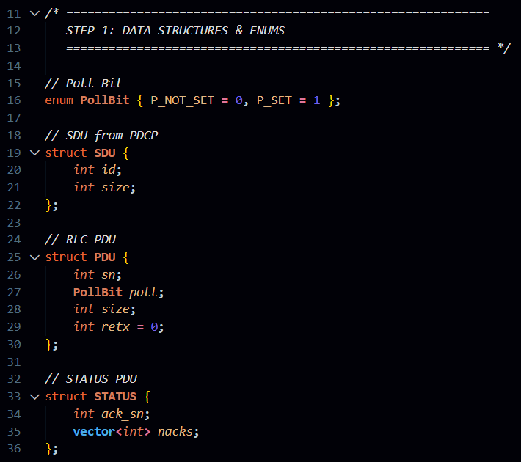
Sample Code
      Phase : 01
The enum keyword is used to create an enumeration named PollBit with two values, P_NOT_SET and P_SET, mapped to 0 and 1, which helps replace numeric values with meaningful names and improves readability.
The struct keyword is used to define custom data types. SDU contains two integers id and size to represent data identity and length. PDU stores a sequence number sn, a PollBit poll value, a size, and retx = 0 to initialize retransmissions. STATUS contains an acknowledged sequence number ack_sn and a vector<int> nacks, where vector is a dynamic array that stores multiple integers.
www.cafetele.com
Specialized Training in:
4G/5G • O-RAN • AI/ML • Network Optimization

Slide 13
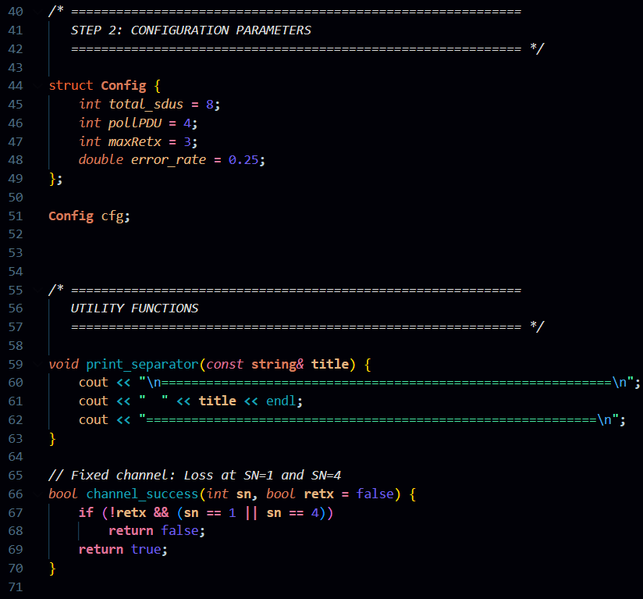
Sample Code
      Phase : 02
This section defines a Config structure that stores simulation settings like total data units, polling interval, maximum retransmissions, and error rate, with default values assigned using =. The statement Config cfg; creates an object to access these settings throughout the program.
The print_separator function formats the output using cout and endl, while const string& avoids unnecessary copying. The channel_success function uses bool and If conditions to simulate transmission failure for specific sequence numbers and returns true or false.
www.cafetele.com
Specialized Training in:
4G/5G • O-RAN • AI/ML • Network Optimization

Slide 14
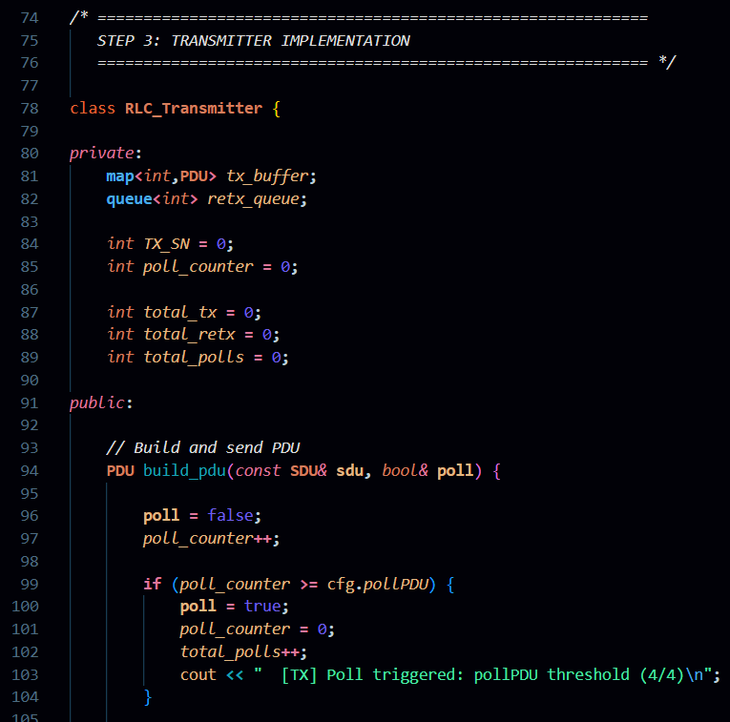
Sample Code
      Phase : 03
This section defines the RLC_Transmitter class, which represents the sender side of communication. The private part stores internal data like tx_buffer for sent packets, retx_queue for retransmissions, and variables such as TX_SN and poll_counter to track sequence numbers and statistics, which are hidden from outside access.
The public part contains usable functions like build_pdu, which creates a PDU from an SDU and decides when to trigger polling. The const SDU& avoids copying data, bool& poll allows updating the poll flag, and the if condition checks the threshold and prints a message using cout.
www.cafetele.com
Specialized Training in:
4G/5G • O-RAN • AI/ML • Network Optimization

Slide 15
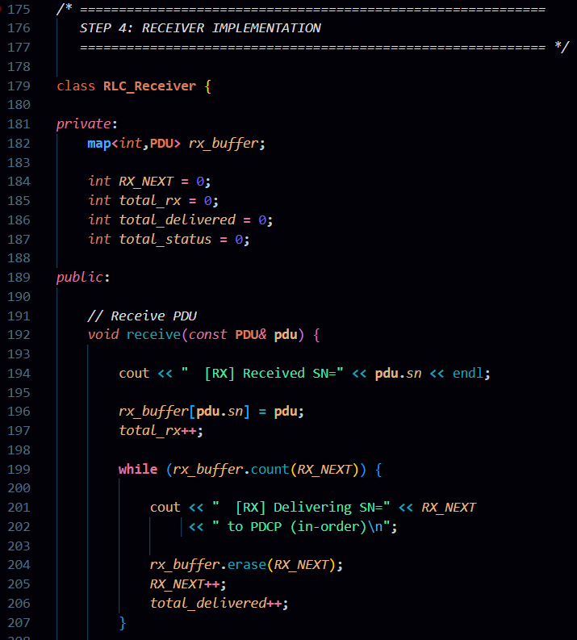
Sample Code
        Phase : 04
This section defines the RLC_Receiver class, which represents the receiving side. Inside the private section, map<int, PDU> rx_buffer stores incoming packets in sequence order. Variables like RX_NEXT, total_rx, and total_delivered track the expected next packet and statistics. Keeping these variables private ensures they are only modified inside the class.
The receive function processes incoming PDUs. It prints the received sequence number using cout, stores the packet in rx_buffer, and increases the counter using ++. The while loop checks if the next expected packet is available using count(). If available, it delivers the packet in order, removes it using erase(), updates RX_NEXT, and increases the delivered count.
www.cafetele.com
Specialized Training in:
4G/5G • O-RAN • AI/ML • Network Optimization

Slide 16
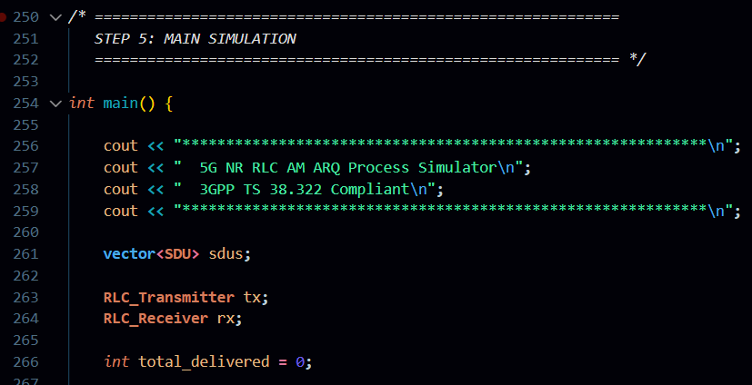
Sample Code
      Phase : 05
This section contains the main() function, which is the entry point of the C++ program. Execution always starts from int main(). The cout statements print the program title and description using formatted text. The vector<SDU> sdus creates a dynamic list to store all data units to be sent during the simulation.
Next, objects RLC_Transmitter tx and RLC_Receiver rx are created to handle sending and receiving operations. The variable total_delivered is used to track how many packets are successfully received. This section controls the overall flow of the program and connects all previous components to run the complete simulation.
www.cafetele.com
Specialized Training in:
4G/5G • O-RAN • AI/ML • Network Optimization

Slide 17
Sample Output
Simulation Results (25% packet loss)
=================================
PHASE 1: SDU Submission from PDCP
=================================
[TX] SDU #0 received from PDCP (100 bytes)
[TX] SDU #1 received from PDCP (150 bytes)
====================================== PHASE 3: STATUS Report Generation (ARQ)
====================================== [RX] STATUS PDU: ACK_SN=1, NACKs=[1,4]
[TX] Processing STATUS: ACK_SN=1
[TX] SN=0 ACKed - removed from buffer
[TX] SN=2 ACKed - removed from buffer
==========================
PHASE 5: Simulation Statistics
==========================
+------------------------------+
| SIMULATION RESULTS |
+------------------------------+
| Total SDUs Submitted: 8 |
| Total PDUs Sent: 8 |
| Total Retransmissions: 2 |
| Total Polls Sent: 2 |
| PDUs Received (Rx): 8 |
| SDUs Delivered (PDCP): 8 |
| STATUS PDUs Sent: 2 |
| Channel Error Rate: 25% |
+------------------------------+
================================
PHASE 2: Initial Transmission & Channel
================================
[TX] SDU #0 received from PDCP (100 bytes)
[TX] SDU #1 received from PDCP (150 bytes)
====================================
PHASE 4: ARQ Retransmissions
====================================
--- Retransmission Round 1 ---
[TX] Retransmitting SN=1 (attempt 1)
[CH] SN=1 >>> Successfully received
[RX] Received SN=1
[RX] Delivering SN=1 to PDCP (in-order)
[RX] Delivering SN=2 to PDCP (in-order)
[RX] Delivering SN=3 to PDCP (in-order)

Slide 18
Advantages and Limitations
Advantages
• Ensures reliable data delivery in lossy channels.
• Follows 3GPP standard specifications.
• Easy to modify parameters for experiments.
• Improves understanding of 5G protocol behavior.
Limitations
• Timers are logically simulated, not real-time.
• HARQ mechanism is not included.
• Graphical visualization is not available.
• Only single-user scenario is implemented.

Slide 19
RLC Failure & Recovery
Failure Trigger
When a PDU exceeds maxRetxThreshold retransmission attempts
RRC Recovery Procedures
1. Report RLC failure to RRC layer
2. Trigger Radio Link Failure (RLF) recovery
3. Attempt RRC re-establishment
4. Perform cell reselection if needed
5. Handover to different cell as last resort

Slide 20
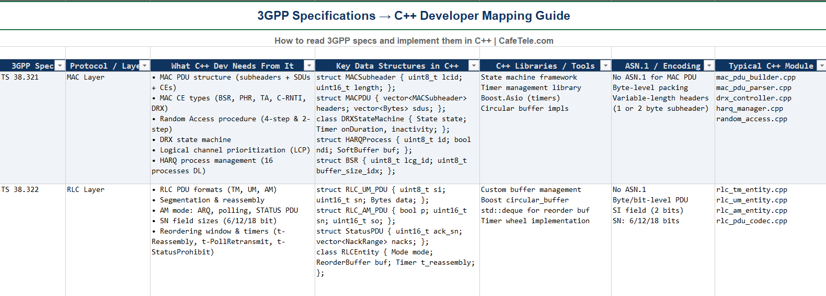
3 GPP Reference

Slide 21
Key Takeaways
ARQ provides reliable delivery at RLC layer through retransmission
Polling mechanism ensures timely STATUS feedback
Window-based flow control prevents buffer overflow
In-order delivery guarantees correct SDU sequencing
Complements MAC HARQ for end-to-end reliability
Implementation follows 3GPP TS 38.322 specification

Slide 22
Thank You!
              Presented By Group : 03
              1. Jayavarshini G
              2. Harshinie M
              3. Yuvaraj P
              4. Shreyash Bhatt
              5. Vikas Srivastava

